Slide 1
IN1013 Databases
01 Overview of Database Technology

Slide 2

Why are ‘Databases on the Web’ Important?
Databases are established technology for managing large amounts of data
The Web is a good way to present information
Separating data management from presentation improves efficiency
updating
finding information
Notes:
2
Web good at displaying - good interface and broad access - but not so good at organising information
Databases are good at organising so combination of both is best. Easier to search for information -the web interface makes everything much more user friendly - user can specify exactly what he's looking for and a dynamically produced page can be composed for that individual - in the correct order as well. You cant do this with static pages.
Managing info - content and appearance separated- different formats/pages can be produced automatically from same data. A good database will also lead to improved accuracy of info - because things are only stored once e.g telephone number is not written in 10 different places I.e one centralized copy kept (you can if necessary control and record versioning information, authoring, amendments, date of changes etc). Changes can be made to everyone instantaneously - update once, - this can be essential for some types of info e.g pricing information, procedures to follow.

Slide 3






Businesses use database technology

Slide 4
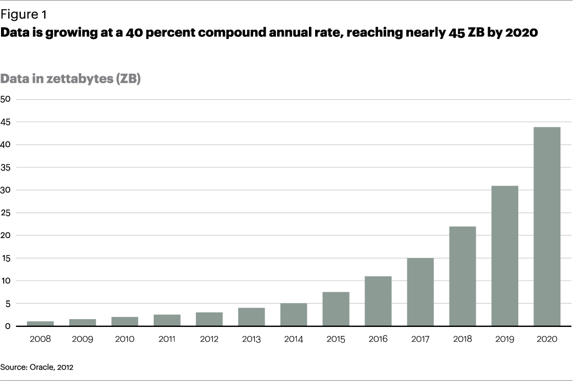
Growing at a rate of %40
1 zettabyte = 1 million million gigabytes

Slide 5
Examples of Websites Using Databases
Organizational information services
employee directories
Booking & scheduling
airlines, university courses signup
Electronic commerce
Website automation
www.google.com
www.webmonkey.com
Notes:
2
Organisational/institutional information services e.g phone directories, libraries, staff information
Facilities booking & timetabling -centralized, easy & flexible access
Electronic commerce - e.g. Web bookshop: amazon.com
Website automation- what I mean here is Web developers without database knowledge are starting to realize the potential efficiency savings of using a database to drive a website.

Slide 6
Databases
Database
an organized collection of data
paper-based
DBMS (database management system)
software to enable user to create and maintain databases
Relational database
organizes data into tables
RDBMS

Slide 7
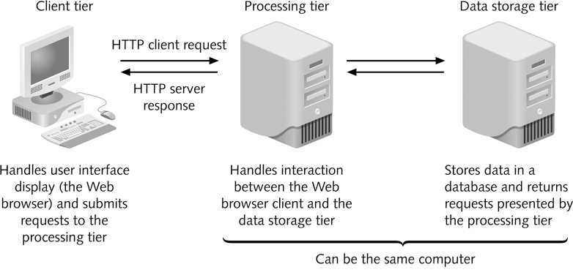
Client/Server Architecture
The design of a three-tier client/server system

Slide 8
How do Databases integrate with the Web?
Databases
MS Access
MySQL, mSQL
Oracle, Sybase, MS SQL Server
Integration tools
Java EE, PHP or CGI, Servlets, JSP, ASP etc.
“Middleware”: e.g. ColdFusion
Browsers (Firefox, Chrome etc)
HTML
CSS
Javascript

Slide 9

Web-enabled database technology
Browser – presentation of data
Integration layer – logic and functionality
Database – storage of data

Slide 10
Client/Server Architecture
HTML
PHP
MySQL
The design of a three-tier client/server system

Slide 11
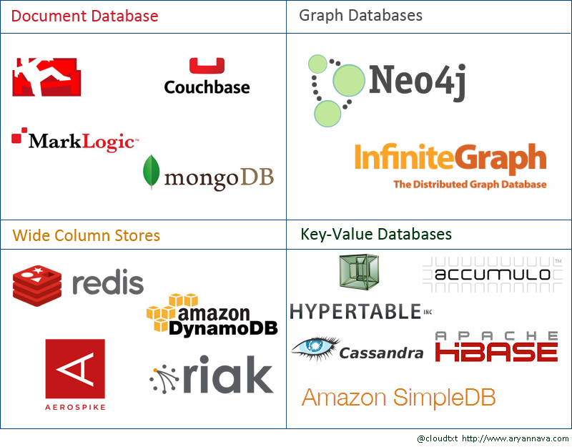
Big Data era – new database technologies

Slide 12
Why Relational Databases are so widely used
Organization - Easy to categorize and store data
Extensible - easy to extend and not reliant on physical organization.
Accuracy: Data is stored just once
Flexibility: Complex queries are easy for users to carry out.
Collaboration: Multiple users can access the same database.
Trust: Relational database models are mature and well-understood.
Security: Data in tables within a RDBMS can be limited to allow access by only specific users.

Slide 13
Next up – Relational Database core concepts

